Slide 1
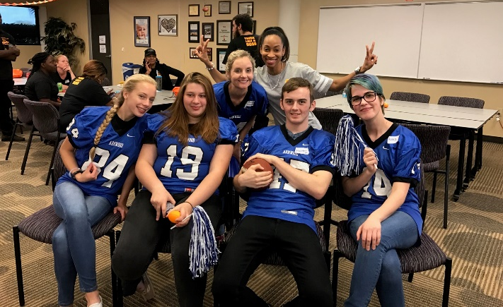
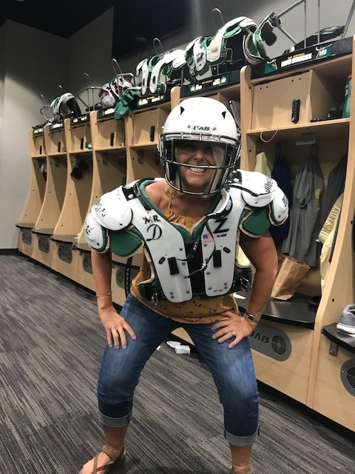
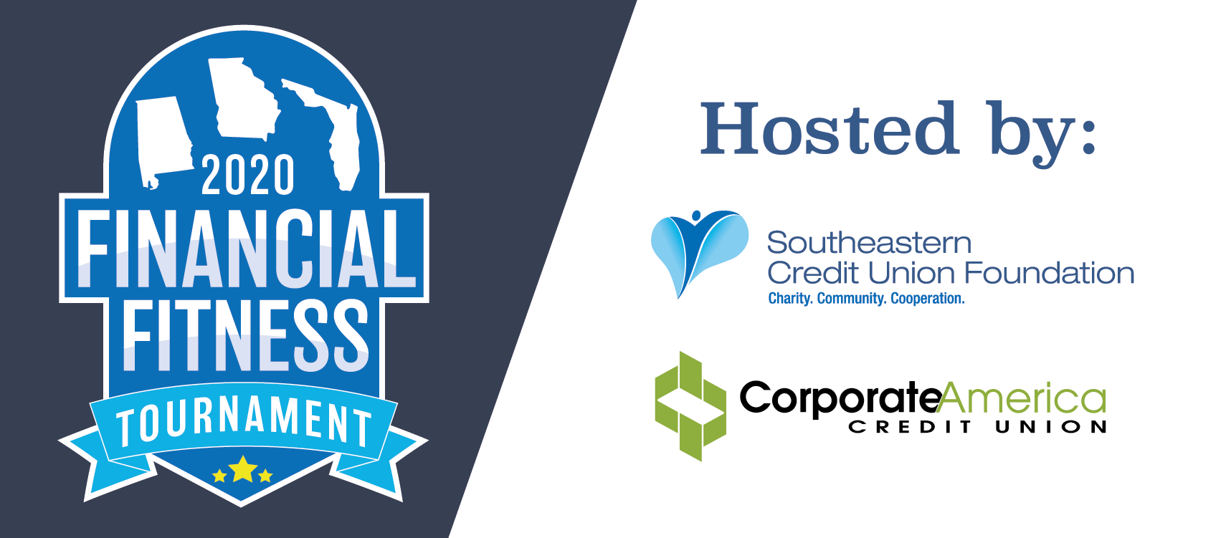
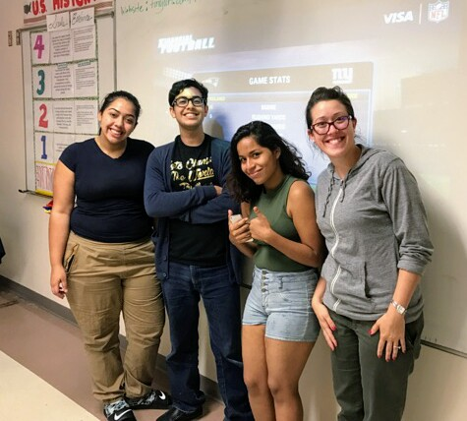
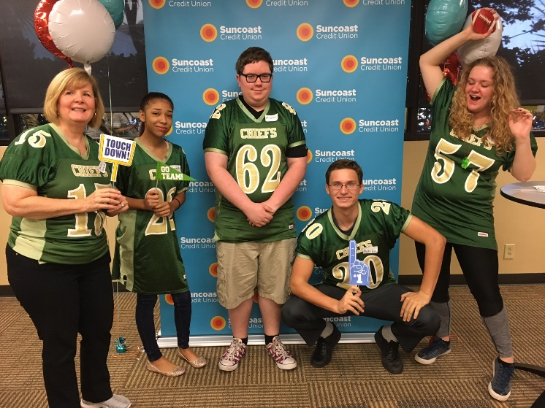
Financial Fitness Tournament

Slide 2
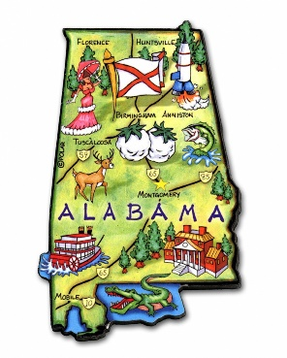
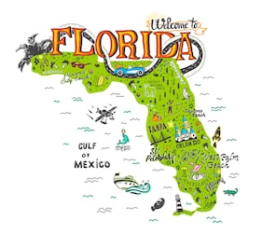
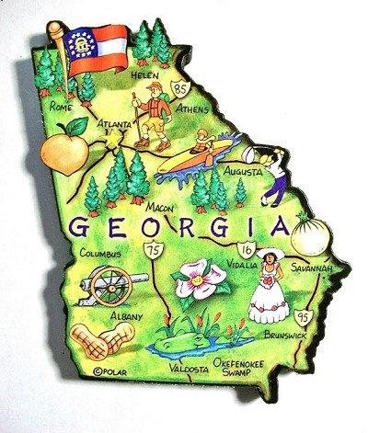
2020 Participating Credit Unions
Family Savings CU
Alabama Teachers CU
Valley CU
All In FCU
ASE CU
Alabama One CU
Naheola CU
Alabama River CU
Suncoast CU
Keys FCU
Grow Financial FCU
Southernmost Chapter
SUN CU
Family Savings CU
Georgia Power Valdosta FCU
Marshland Community FCU
Go Energy Financial CU

Slide 3
Why do Credit Unions Care?
44% of Americans don’t have enough cash to cover a $400 emergency.
The median out-of-pocket cost for an unexpected medical expense is $1,000, which means nearly half of our country is just one accident away from being hit with a bill they can’t afford to pay.
43% of student loan borrowers are not making payments.
Tuition at public four-year institutions has increased by 213% in the past 30 years and nearly half of the 22 million Americans with federal student loans are either behind on payments or received permission to postpone payments due to economic hardship.

Slide 4
Not-So-Shocking Stats
38% of U.S. households have credit card debt.
On average, they owe $16,048 with an APR of 16.47%.
The median out-of-pocket cost for an unexpected medical expense is $1,000, which means nearly half of our country is just one accident away from being hit with a bill they can’t afford to pay.
33% of American adults have $0 saved for retirement.
Furthermore, 56% of American adults have less than $10,000 saved for retirement when you combine the 33% who have nothing saved with the 23% who have a small amount saved.
Considering the fact that most Americans will need at least $1 million to retire and Millennials will likely need between $1.8 and $2.5 million, our savings rate is terrifying.

Slide 5
Take the Field for Financial Education!
Who can hold a competition?
The competition can be held by an individual credit union or done as a Chapter or YP event.
Who are the teams?
The financial fitness tournament material is suggested for middle school – college age students (rookie level, pro level and hall of fame level).
What can the students win?
Prizes are up to the credit union(s) hosting the event. Of course, the financial knowledge is priceless!
What can the credit union gain?
Hosting a competition is a great way to connect with local schools and/or youth agencies, to spread credit union awareness and potentially, to gain new young members (and their families). Financial education programs are also great to share with your local media and lawmakers.

Slide 6
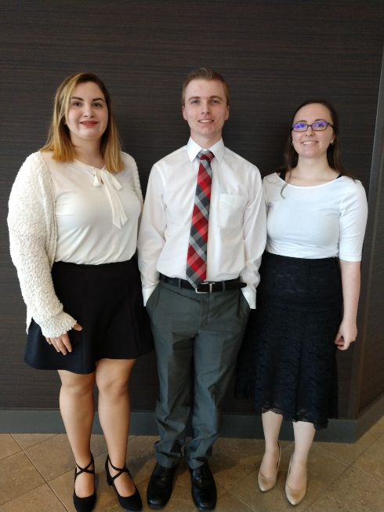
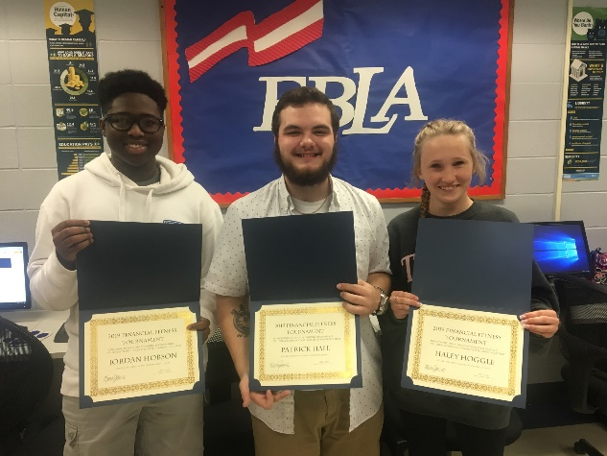
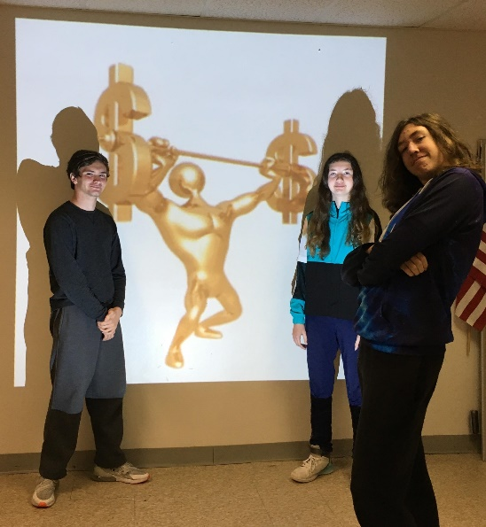
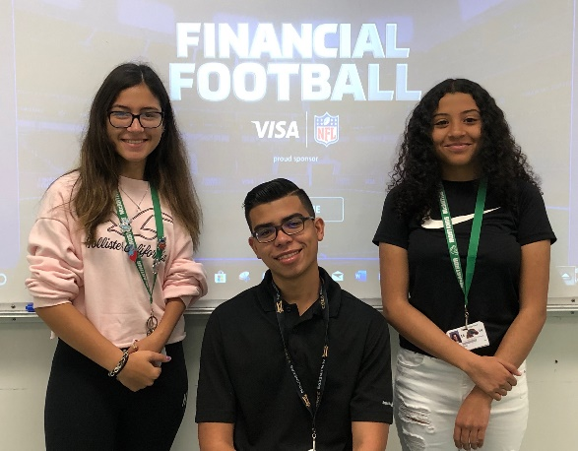
Get Ready to Rumble!
2021 Financial Fitness Timeline
Competitions can be done anytime throughout the year but here are some important things to remember:
Allow at least 2 months to get teams signed up.
Allow at least 1 month for teams to study the materials.
Give a 1-week window for all teams to complete and submit their 3 consecutive online games for scoring.
Coordinate with other credit unions within your Chapter if you plan to do a Chapter Championship.

Slide 7
2020 SECUF Tournament Winners
2020 was the 4th and last year that we held a League-wide Championship competition. Thank you to all participating credit unions, students, teachers and to Corporate America Federal Credit Union for making these tournaments possible!
During a time when students were losing out on the last semester of in-person school, prom, graduation events, sports and social interaction, the Southeastern Credit Union Foundation found a way to keep two of our main financial education events alive. The Financial Fitness Tournament, where credit unions can work with teams of high school students to educate them on various financial topics and then motivate them to compete against other teams all across the states of Florida, Alabama and Georgia in a head to head trivia style competition, was altered to become an individual competition. Students were sent a link that contained the study material and online game. Each student then competed online in May and earned an overall “financial fitness score” based on various criteria. Out of 41 students finishing out the season, representing 13 Chapters, our 2020 winners were as follows:

Slide 8
Coming in 3rd Place…
Ashley Pond
Key West, FL
Keys FCU
Lauren Hanvey
Gadsden, AL
Family Savings CU
Michael Osmer
Mobile, AL
Naheola CU

Slide 9
Coming in 2nd Place…
Heidy Gonzalez
Hollywood, FL
SUN CU
Micayla Holland
Gadsden, AL
Family Savings CU
Vaneeza Rupani
Tuscaloosa, AL
Alabama One CU

Slide 10
And now for your 1st Place 2020 Financial Fitness Tournament Champions…
Sebastian Brito
Tampa, FL
Suncoast CU
Verity Pond
Key West, FL
Keys FCU
Will Hinds
Tuscaloosa, AL
Alabama One CU

